Slide 1
Ambulatory Surgical Centers
Surveyor Training
March 28, 2025
Beverly Robins, MBA, BSN, RN
Loyola University - Chicago

Slide 2
ASC Discussion Topics
Distinct Entity
Direct Observation Surveys
New Standards
Handling Consultants
Patient Interviews & Consent
Chapter 13 Citations
Notice of operations vs. transfer agreement
Medicare class applicability

Slide 3
On completion of this training, you will be able to identify:
Identify compliance issues related to distinct entity requirements in ASCs.
Apply ASC regulations and survey procedures to assess compliance effectively.
Engage in open discussions to learn from peer surveyors’ experiences and challenges.

Slide 4
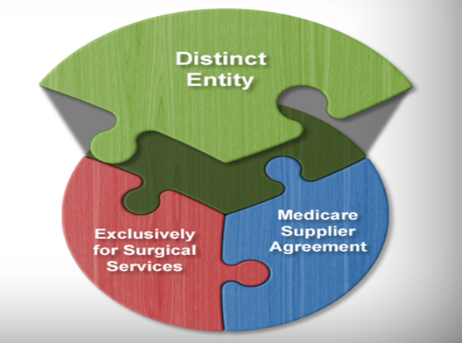
Distinct Entity
CMS Conditions for Coverage defines an ASC as any
Distinct entity
Operates exclusively for the purpose of providing surgical services to patients not requiring hospitalization and in which the expected duration of services would not exceed 24 hours following an admission
Has an agreement with Medicare to participate as an ASC; and it complies with the Conditions for Coverage (CfCs)

Slide 5
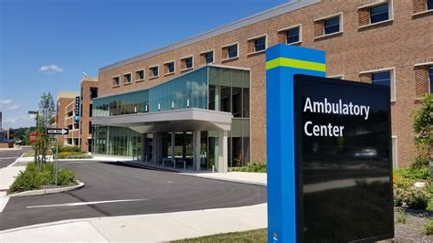
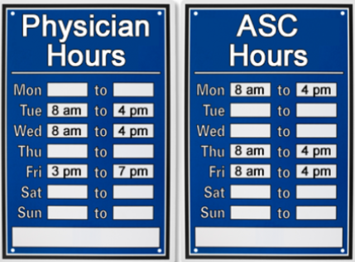

Slide 6
Distinct Entity
What degree of separation is necessary to meet the definition of an ASC?
One of the more frequent survey citations we see involves a waiting room shared between the practice and the ASC.

Slide 7
Space Sharing Between ASCs & Physician Offices
An ASC and physician's office may share space if they have temporal separation - meaning they operate at different times with no overlapping usage."
Separate Licenses
Separate Staffing
Temporal Separation
Another Medicare Entity
An ASC and physician's office may share space if they have temporal separation - meaning they operate at different times with no overlapping usage."

Slide 8
Distinct Entity
An ASC does not have to be completely separate and distinct physically from another entity, if, and only if, it is temporally distinct.
The same physical premises may be used by the ASC and other entities, so long as they are separated in their usage by time.

Slide 9
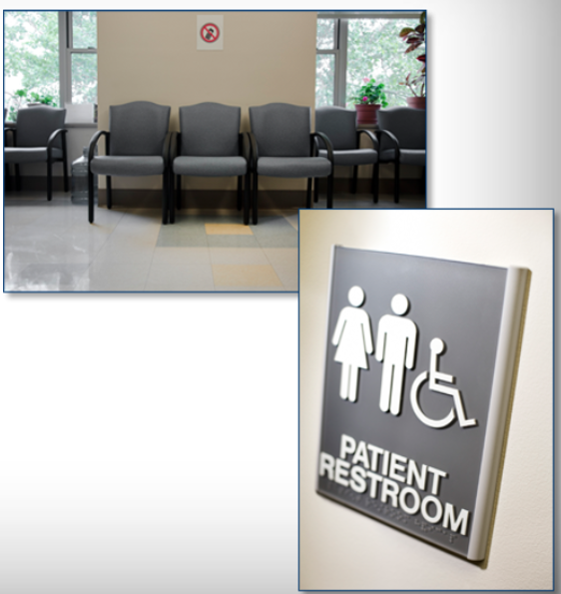
Distinct Entity
CMS permits certain common, non-clinical spaces, such as a reception area, waiting room, or restrooms to be shared between an ASC and another entity, as long as they are never used by more than one of the entities at any given time, and as long as this practice does not conflict with State licensure or other State law requirements.
The common space may not be used during concurrent or overlapping hours of operation of the ASC and the physician office.

Slide 10
Distinct Entity Citation
An ASC may not share space with another entity when the ASC is open.
When an ASC is found to have a waiting area that is not separated appropriately from another entity, this is cited as a violation of both 42 CFR 416.2 and 42 CFR 416.44(b) – LSC noncompliance identified.
9-A-0 – Governing Body (Condition-level Citation)
Ambulatory surgical center or ASC means any distinct entity that operates exclusively for the purpose of providing surgical services to patients not requiring hospitalization and in which the expected duration of services would not exceed 24 hours following an admission. The entity must have an agreement with CMS to participate in Medicare as an ASC, and must meet the conditions set forth in subparts B and C of 416.2.

Slide 11
Compliance Determination
Interview the ASC staff to help you further determine if the ASC and the physician’s office are separated temporally. Ask questions such as:
Do you work for both the ASC and the physician’s office? If so, tell me about your duties on ASC days versus physician office days. Do those duties overlap?
Do you ever have ASC patients in the waiting room at the same time as patient for the physician’s office?

Slide 12
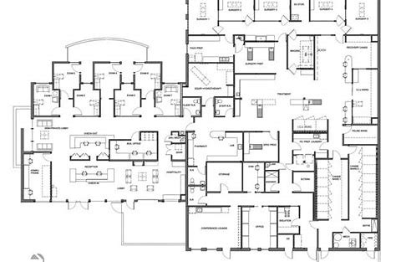
Distinct Entity – Question
We have a surgeons that has a private practice that is completely separate and distinct in all other respects; however, there is one shared EMR. Is the physician required to have two EMR's, one for the ASC and another for the practice? Or, is it okay if staff access is permission based?

Slide 13
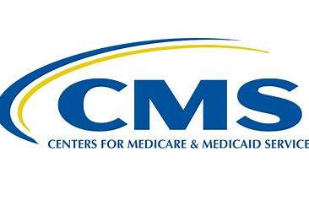
Distinct Entity – CMS Response
This is not a distinct entity issue. So just the mere fact that the physician practice and the ASC share a record, that doesn't mean it is not a distinct entity.”
“We” [CMS] have tried to address this issue in the guidance in trying to be very clear that we don't get into that kind of “stuff” in terms of you looking to see that you can find a distinct medical record that you can clearly see that this is the ASC file; that these are all the documents that went with the ASC file. That could be permissions, that could be a separate folder, that could be a separate visit, or something like that. All of those issues of sharing the EMR and sharing who has access to it, that's OCR, that's HIPAA and all the high-tech rules.

Slide 14
Distinct Entity – SOM Appendix L
In other words, if a physician owns an ASC that is located adjacent to the physician’s office, the physician’s office may, for example, use the same waiting area, as long as the physician’s office is closed while the ASC is open and vice-versa. The common space may not be used during concurrent or overlapping hours of operation of the ASC and the physician office.
Furthermore, care must be taken when such an arrangement is in use to ensure that the ASC’s medical and administrative records are physically separate.

Slide 15
Distinct Entity Clinical Record
If surveyors observe that patient record information is scattered across an integrated system, requiring you to navigate through unrelated practice files to locate necessary documentation, this could raise compliance concerns for state entities. CMS encountered significant challenges with this issue approximately six to seven years ago, when surveyors frequently cited facilities for using integrated EMR systems.

Slide 16
Distinct Entity – Rent Space
Is the ASC permitted to rent space to other another Medicare-certified entity?

Slide 17
Distinct Entity – Rent Space
While the ASC is open it is the only entity permitted to use space within the walls of the ASC.

Slide 18
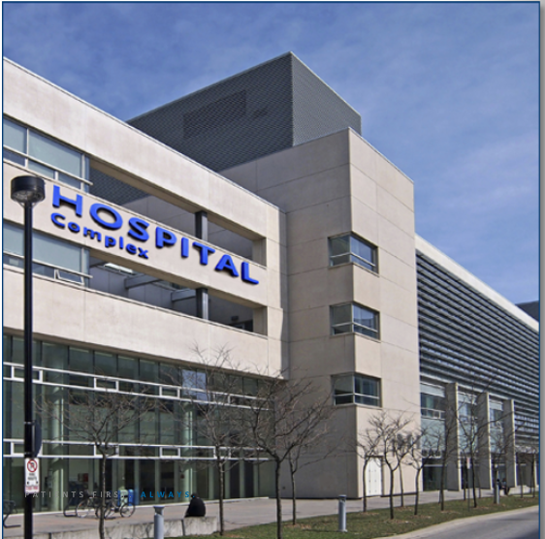
Distinct Entity – No Exceptions
ASCs may not share space, even when temporally separated, with the following entities:
Hospitals
Critical Access Hospitals (CAH)
Independent Diagnostic Testing Facilities (IDTF)

Slide 19
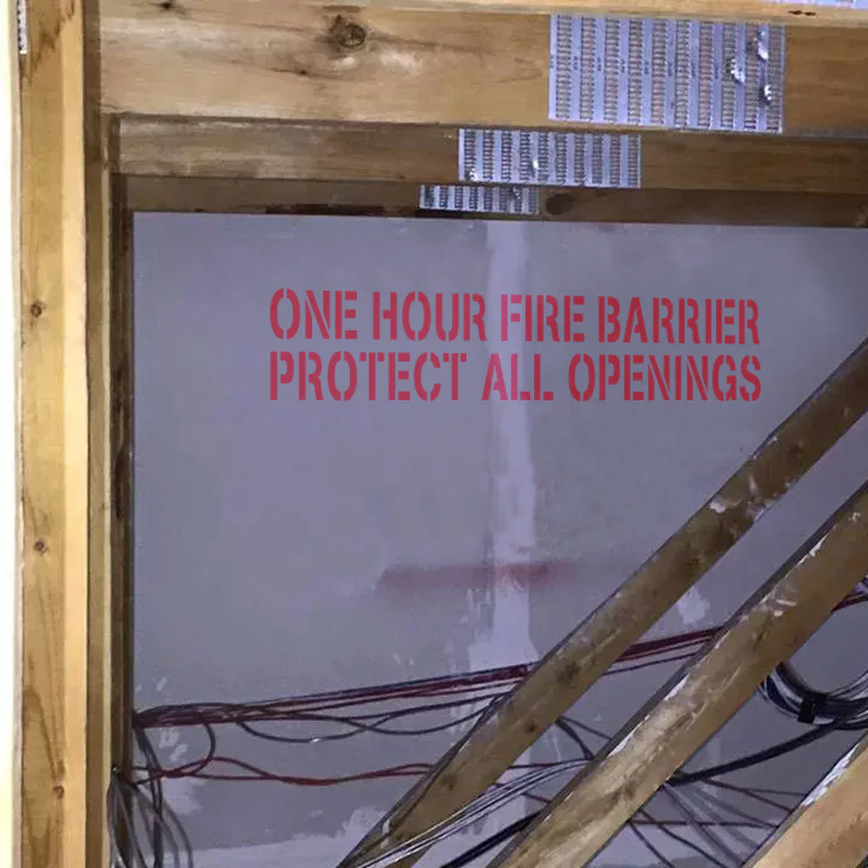
Knowledge Check
QUAD A and CMS expects the Ambulatory Surgical Center ASC health surveyor to determine if a wall has at least a 1-hour separation.
True
False

Slide 20
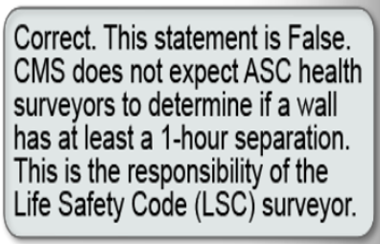
Knowledge Check
QUAD A and CMS expects the Ambulatory Surgical Center ASC health surveyor to determine if a wall has at least a 1-hour separation.
True
False

Slide 21
Prohibited Services in ASCs
Services unrelated to the surgical procedures performed in the ASC are not allowed.

Slide 22
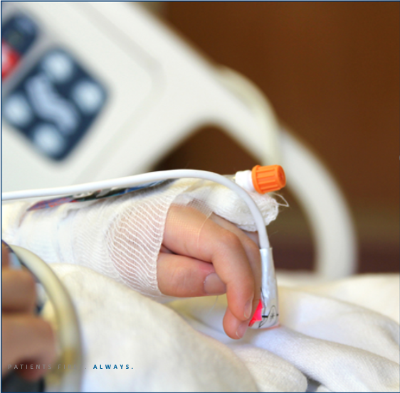
Scenario: 6-year-old ENT post-surgery
While sedated, the ASC nurse performed allergy testing on the boy to avoid a separate appointment.

Slide 23
Prohibited Services in ASCs
Violation: Allergy testing falls outside the ASC’s defined scope of an ASC which functions to provide surgical services (42 CFR 416.2).
Surveyor Action Required: Cite Condition-level finding at 9-A-0 for non-compliance with ASC Conditions for Coverage.

Slide 24
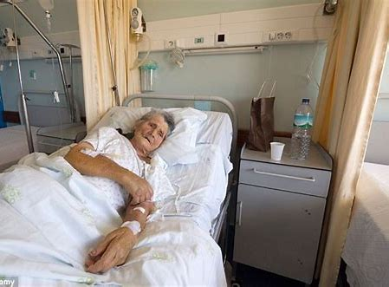
The Need for Hospitalization in ASCs
Hospitalization = Supervised recovery in an inpatient facility.
ASCs are for procedures where patients can recover within 24 hours. Hospitalization needs disqualify a procedure from ASC settings.
Example: A 4-hour spinal fusion on a diabetic patient may require hospitalization due to extended recovery and monitoring needs.
Nature of the Surgery
Procedure length
Complexity/risk level
Patient Characteristics
Comorbidities
Recovery needs
Notes:
ASCs are for procedures where patients can recover within 24 hours. Hospitalization needs disqualify a procedure from ASC settings.
A 4-hour spinal fusion on a diabetic patient may require hospitalization due to extended recovery and monitoring needs.
"How would you assess a borderline case (e.g., a 2-hour procedure for an elderly patient with mild hypertension)?"
Surveyors must review both procedure and patient factors during assessments.

Slide 25
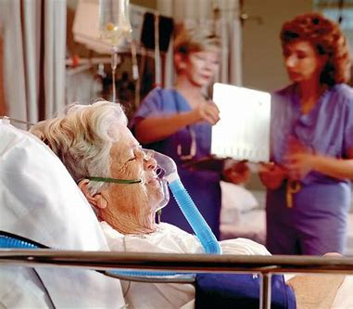
The Need for Hospitalization in ASCs
Key Factors for ASC Eligibility:
Nature of the Surgery
Procedure length
Complexity/risk level
Patient Characteristics
Comorbidities
Recovery needs
Notes:
ASCs are for procedures where patients can recover within 24 hours. Hospitalization needs disqualify a procedure from ASC settings.
A 4-hour spinal fusion on a diabetic patient may require hospitalization due to extended recovery and monitoring needs.
"How would you assess a borderline case (e.g., a 2-hour procedure for an elderly patient with mild hypertension)?"
Surveyors must review both procedure and patient factors during assessments.

Slide 26
Recovery Center Oversight
ASC Compliance Focus:
Verify ASC meets all Conditions for Coverage (CfCs)
Ensure proper patient transfer protocols
Surveyor Focus on the ASC’s adherence to CfCs, including:
Transfer agreements with hospitals (if required).
Discharge protocols (e.g., ‘responsible adult’ accompaniment).
Documentation of patient stability before transfer.
If an ASC routinely sends high-risk patients to a ‘recovery center’ with 48-hour stays, this warrants CMS RO involvement so please notify QUAD A.

Slide 27
Some states allow ASCs to discharge patients to unlicensed "recovery centers" that provide post-operative care (for non-Medicare patients only)
Recovery centers are:
Not Medicare-certified facilities
Not licensed hospitals
Regulatory Conflict:
Routine use of recovery centers may indicate:
Patients actually needed hospitalization-level care
Potential non-compliance with ASC Conditions for Coverage
Compliance Implications:
Surveyors should:
Review patient discharge patterns
Assess whether recovery center use suggests hospitalization needs
Verify ASC meets all regulatory requirements for patient discharge

Slide 28
ASC Services < 24 hours
When does the clock begin ticking?
When does it end?

Slide 29
ASC 24-Hour Rule: Regulatory Foundation
Expected duration of services not to exceed 24 hours following an admission.
Critical Components:
Review pre-op documentation for planned procedure duration
Verify discharge records match actual patient exit times
Cross-check anesthesia logs for time discrepancies
Compliance Verification: ✔️ Confirm no patient stays >24 hours in past 12 months ✔️ Review policy defining "admission" and "discharge" ✔️ Audit 5 surgical records for timeline accuracy
Common Violations: ❌ Counting "procedure time" only (ignoring pre/post-op) ❌ Failed discharges (e.g., patient remains >24h due to complications) ❌ No documentation justifying near-miss cases (23-24h stays)

Slide 30
Exceptions to the 24-Hour Rule
Patient Care Priority:
ASCs must never discharge unstable patients solely to meet the 24-hour rule
Facility remains fully responsible for care until safe discharge
Regulatory Context:
24 hours = expected maximum (per 42 CFR §416.2)
Occasional exceptions allowed for unforeseen complications
Compliance Red Flags:
Frequent or planned exceedances
Suggests facility may be operating beyond ASC scope

Slide 31
When reviewing cases that exceed 24 hours – Surveyors should:
Verify Medical Necessity:
Example: A patient developing postoperative bleeding at 23h30m requires continued care - this is justified.
Documentation Check: Look for operative notes detailing the complication.
Assess Patterns:
Ask: 'How many cases exceeded 24 hours in the past year?'
Threshold: >2-3 cases/year warrants deeper review of case selection.
Enforcement Guidance:
Isolated Incident: Note in report but don’t cite if properly documented.
Recurring Issue: Cite under 9-A-0 42 CFR 416.2 (ASC definition violation).

Slide 32
Managing Entry Challenges During Unannounced Surveys What Do You Do When The Administrator Is Not Available?
Common ASC Staff Responses:
"Could you come back another day?“
"You can’t come in—we have patients to deal with.“
De-escalation: Phone home if you need assistance.

Slide 34
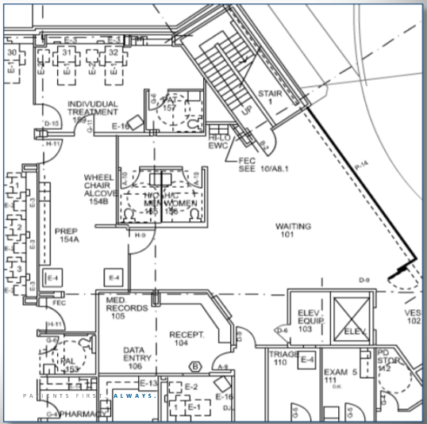
Scope of Survey
Exam Rooms
Procedure Rooms
Medication Storage Areas
Operating Rooms
Administrative and records area
Recovery Areas
Waiting Areas
OTHERS???

Slide 35
Conducting Effective Patient Interviews During ASC Surveys (***DOV Survey***)
Patient interviews provide critical insights into care quality but require special sensitivity. Unlike staff interviews, patients may feel vulnerable or fearful of repercussions.
Best Practices:
Reassurance: "Your answers won’t affect your care – we’re here to improve safety."
Neutral Questions: “Did staff explain your discharge instructions clearly?"
Private Setting: Always interview away from staff/other patients
4. OTHER TIPS?

Slide 36
Patient Interviews Questions
About Their Care:
"Can you describe your experience with the care you received?"
Procedure Knowledge:
"What were you told about your surgery/procedure beforehand?"
Consent Process:
"How did staff explain your options? Who walked you through consent?"
Discharge Understanding:
"What instructions did you receive about recovering at home?"
Awareness of Rights:
"What do you know about your rights as a patient here?"
OTHERS?

Slide 37
Patient Consent for Case Observation
Consent Requirement:
Patient's surveyor observation consent must be included in their original informed consent documents
Physician Consent:
❌ Not required to obtain operating physician's permission
✅ Must ensure observation:
Never compromises patient safety
Does not interfere with the procedure
Surveyor Responsibility:
Position discreetly (e.g., behind glass or at a designated observation area)
Immediately withdraw if requested by clinical team for safety reasons

Slide 38
Principles of Documentation
Documentation must contain:
WHO
WHAT
WHEN
WHERE
HOW
🔍 Direct observation
💬 Staff interview
📄 Document review

Slide 39
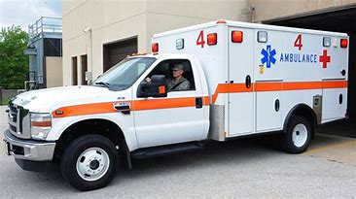
Notice of Operations vs. Transfer agreement
2019 CMS noted the removal of:
“… the provisions requiring ASCs to have a written transfer agreement with a hospital that meets certain Medicare requirements or ensuring that all physicians performing surgery in the ASC have admitting privileges in a hospital … [but ASCs still] will be required to periodically provide the local hospital with written notice that outlines the ASC operation and patient population served by the ASC facility. All ASCs must continue to have an effective procedure for immediate transfers to a hospital for patients requiring emergency medical care beyond the capabilities of the ASC.
9-B-1 The facility must provide the local hospital with written notice of its operations and patient population served upon opening and at least bi-annually. 416.41(b)(3) Standard

Slide 40
Chapter 13 Citations

Slide 41
Sub-section A: Governing Body
9-A-19 - The governing body of the facility coordinates, develops, and revises the organization's policies and procedures to specify the types of emergency equipment required for use in the organization's operating room.
Applicability: ASC
Class: A, B, C
Notes:
This is a new standard
Interpretive Guidance:
The intent is to ensure the accountability of the governing body that the facilities policies and procedures address the types of emergency equipment required for use in the organization’s operating room.
Although the governing body is ultimately responsible and accountable for these policies and procedures, medical staff, anesthesia professionals, and nursing staff should be involved in specifying the types of emergency equipment required for use in the organization’s operating room.
Evaluating Compliance:
• Interview staff.
• Review governing body meeting minutes.
• Are the types of emergency equipment present in the operating room consistent with the governing body specifications?

Slide 42
Sub-section B: Transfer Agreement
9-B-1 - The facility must provide the local hospital with written notice of its operations and patient population served upon opening and at least bi-annually.
Applicability: ASC, OBP, OBS, OMS
Class: A, B, C
Notes:
This standard no longer applies to OBP, OBS, and OMS

Slide 43
Role of Leadership & Consultants During Staff Knowledge Assessments
Consultants Must Remain Silent
Leadership’s Limited Role
Enforcement of Non-Interference

Slide 44
CMS Findings/Action Item:
In one of twenty records (AO ID # 6408), it was noted that surveyors were onsite at the ASC from 9am to 3pm which does not meet the QUAD A’s policy for surveyors to be onsite a minimum of 8 hours. CMS and QUAD A staff discussed the use of one day surveys in ASCs. CMS acknowledges that QUAD A does send 2 surveyors for one day on Medicare full surveys.
ACTION ITEM: QUAD A must submit a corrective action plan to ensure surveyors are adhering to the policy for a minimum of 8 hours onsite.

Slide 45
Surveyor time spent on survey
2 surveyors, 1 day – 9am to 3pm
2 surveyors, 1 day –7am to 5pm
2 surveyors, 1 day – 8am to 1615
2 surveyors, 1 day – 5:40am to at 2pm
2 surveyors, 1 day – 8am to 1615
2 surveyors, 1 day – 7:30am to 3:30pm
2 surveyors, 1 day – 0730 to 2000
2 surveyors, 1 day – 0745 to 1645
2 surveyors, 1 day – 0745 to 2200 why are surveyors still onsite at 10pm instead of respecting staff time and doing a second day? Per ASC info – they are open until 4pm
2 surveyors, 1 day – 0730 to 1630
2 surveyors, 1 day – 0655 to 4:10pm
2 surveyors, 1 day – 7am to 1530
2 surveyors, 1 day – 0730 to 1715 (IJ)
2 surveyors, 1 day – 0600 to 1430 (IJ)
2 surveyors, 1 day – 6:30am to 2:30pm
2 surveyors, 1 day – 0700 to 1500
2 surveyors, 1 day – 0745 to 1645
2 surveyors, 1 day – 8am – 4pm ( IJ – 81 def.)

Slide 46
Immediate Jeopardy Level Noncompliance
For surveyors to cite an immediate jeopardy there either has to be a situation, created by non-compliance, in which an individual has been harmed OR there must be the “likelihood” that serious harm, injury, impairment or death will occur if the identified non-compliance is not immediately corrected.
Likelihood is referenced as a “reasonable expectation” that serious harm will occur. This is a shift from the previous guidance used by surveyors that the “potential” for serious harm was sufficient to trigger an Immediate Jeopardy.
Last but not least, with the new guidance, surveyors must determine if deficiencies have “caused or made likely serious mental or psychosocial harm”. Surveyors have been instructed to utilize the reasonable person concept in making this determination. The reasonable person approach encourages persons to consider how a reasonable person in the recipient's position would be impacted by the noncompliance.

Slide 47
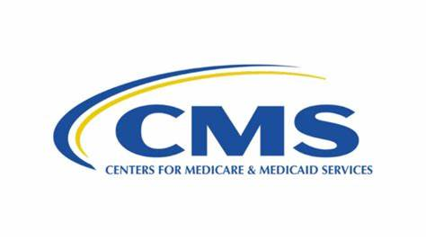
Examples: Potential Immediate Jeopardy Noncompliance

Slide 48
Immediate Jeopardy Level Noncompliance
Staff members walking through the sterile operating room in street clothes
Not having mandated emergency equipment and medications on site
No tracking of controlled and regulated medications such as narcotics
Physicians and staff not having current licenses and credentials
Using single use items more than once, on more than one patient
Equipment is reprocessed without proper cleaning
Failed to ensure that single dose vials/ampoules were used for just one patient
Nursing staff is not always available to patients in case of an emergency
Failed to ensure that medications were not kept beyond use date
The OR (Operating Room) suite is not maintained to avoid sources of transmission of infection

Slide 49
Immediate Jeopardy Level Noncompliance
Failed to have an infection control program under the direction of a qualified professional who has training in infection control
Failed to ensure that medications for single patient use are used for just one patient and that pre-drawn syringes are properly labeled
Failed to ensure that an ongoing surveillance program to prevent and control infections and other communicable diseases was maintained
Failed to ensure that proper storage for all sterile items was provided
Facility failed to provide personnel with qualifications, orientation, and on the job training for the sterile processing
Failed to ensure that general anesthesia was provided in a safe manner
Failed to ensure that equipment was maintained in a safe manner
Lack of appropriately credentialed sterile processing staff and infection control practices
No evidence that the sterile instruments were prepared and packaged to be consistent with nationally recognized guidelines

Slide 50
Immediate Jeopardy Level Noncompliance
Failed to ensure that laboratory services provided in safe and effective manner
Failed to ensure that all patients are fully informed regarding procedures and treatments, in terms that are understandable for the patient
Failed to ensure that anesthesia is administered in accordance with the (State) regulations
Failed to ensure that all intravenous fluids were administered according to acceptable standards of practice
Failed to discharge patients in the company of a responsible adult except if exempted by the attending physician
Failed to have proper emergency medications Failed to maintain complete, comprehensive and accurate medical records to ensure adequate patient care
Unplanned emergency hospital transfer sent to E.R. in car with wife – no evidence that patient’s wife was capable of handling emergency situation
Failed to track adverse patient events, examine their causes, implement improvements, and ensure that improvements are sustained over time

Slide 51
Quality Report – ASCQC: Wrong Site Stratification Represents 2,602,162 patient admissions seen at 2,121 ASCs
2024Q3 Rate of Wrong Site, Side, Patient, Procedure, Implant Events | 0.019 per 1000 admissions

Slide 52
Immediate Jeopardy Level Noncompliance
CMS has also advised surveyors that there are no automatic immediate jeopardy citations or situations. Each individual situation needs to be evaluated.

